Slide 1


Slide 2


The Boon Group Enrollment Site
Enroll Online is a site employees use to enroll in their benefits.

Slide 3

Login screen
Employees can access Enroll Online at https://private.boongroup.com/enrollonline
If the employee has not created a login, they will click “Create a new login.”
If the employee has already created a login and password, they will enter it here.

Slide 4
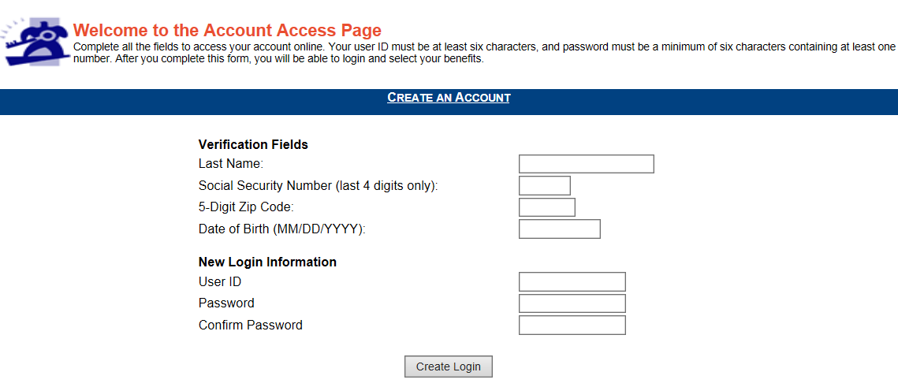
Create an Account
The employee will fill out:
Last name
Last 4 digits of SSN
5 digit zip code
Date of birth
This needs to match what we have in the system for the employee.
The employee then creates a user ID and password.
The user ID must be at least six characters, and password must be a minimum of six characters containing at least one number.

Slide 5
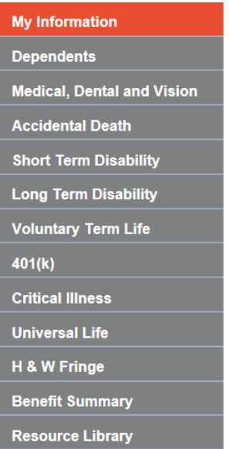
Navigation Tabs
Users can click on each tab to look at specific plans or information throughout the Enroll online site.
What is shown here would be dependent upon the plans your group is offering.

Slide 6
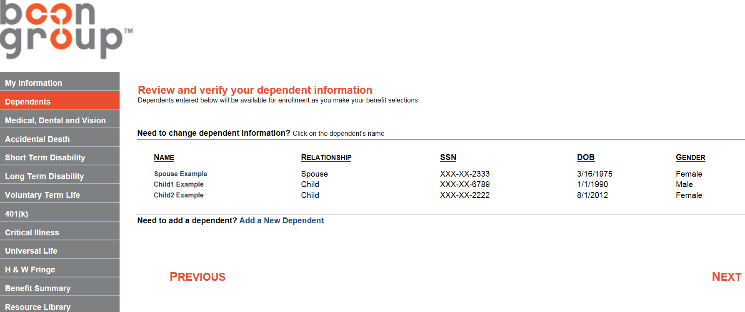
Dependent Page
Users can add information for dependent(s) they want to enroll in any of their plan options.

Slide 7
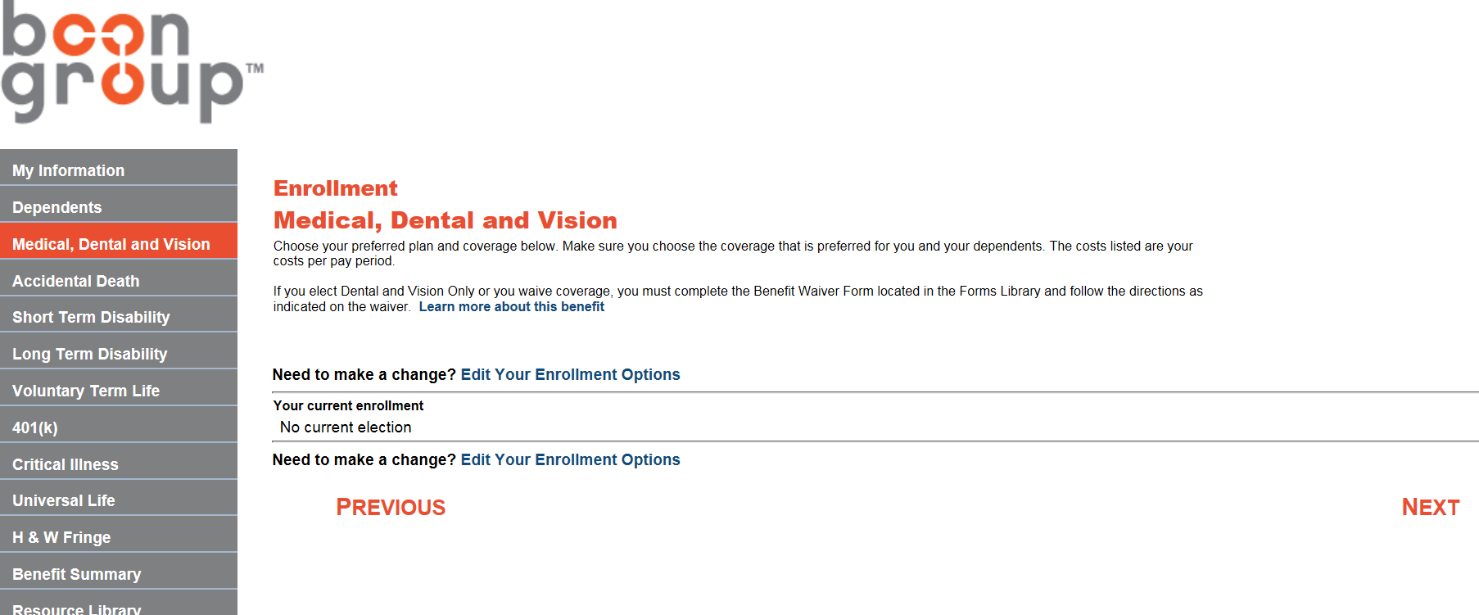
Benefits Page
Click any of the benefits you wish to enroll in.
The first page will show current elections. To make changes, click “Edit Your Enrollment Options.”

Slide 8
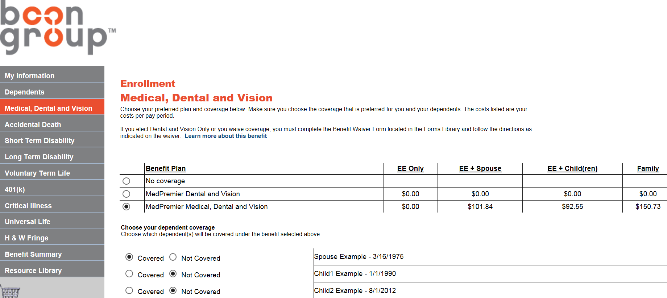
Benefits Page
Once users click “Edit Your Enrollment Options,” they can choose their plan and dependent(s) coverage.

Slide 9
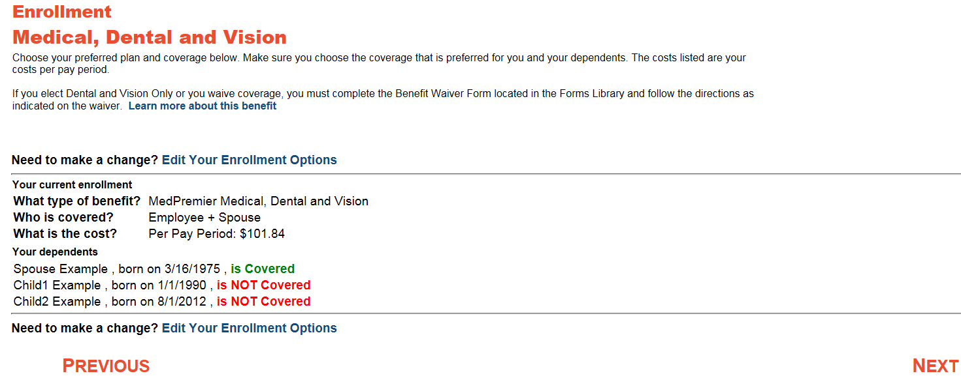
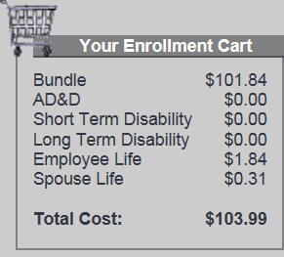
Benefits Page
Once users have chosen a plan and dependent(s) coverage, they are shown their enrollment. By clicking “Next,” users have confirmed their enrollment into that plan and the Enrollment Cart is updated.
The Enrollment Cart at the bottom left hand corner of the page lists plans you are enrolled in and total deduction per pay period.

Slide 10
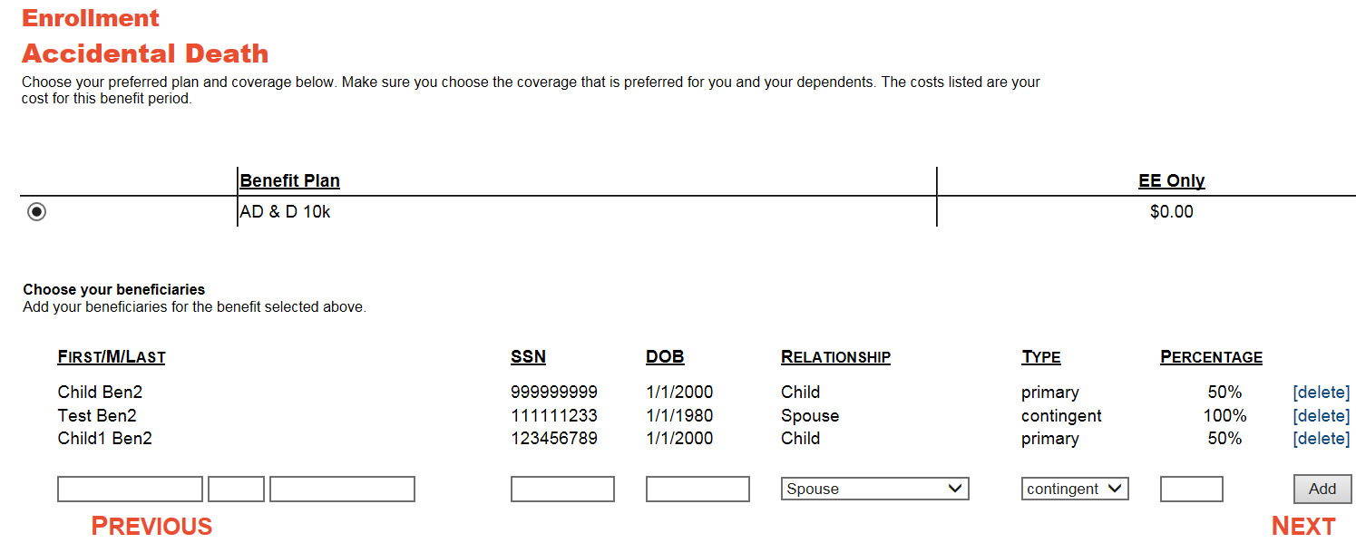
Enrollments with Beneficiaries
For any benefit that includes a beneficiary,
the employee can add their beneficiary,
along with the type and percentage.

Slide 11
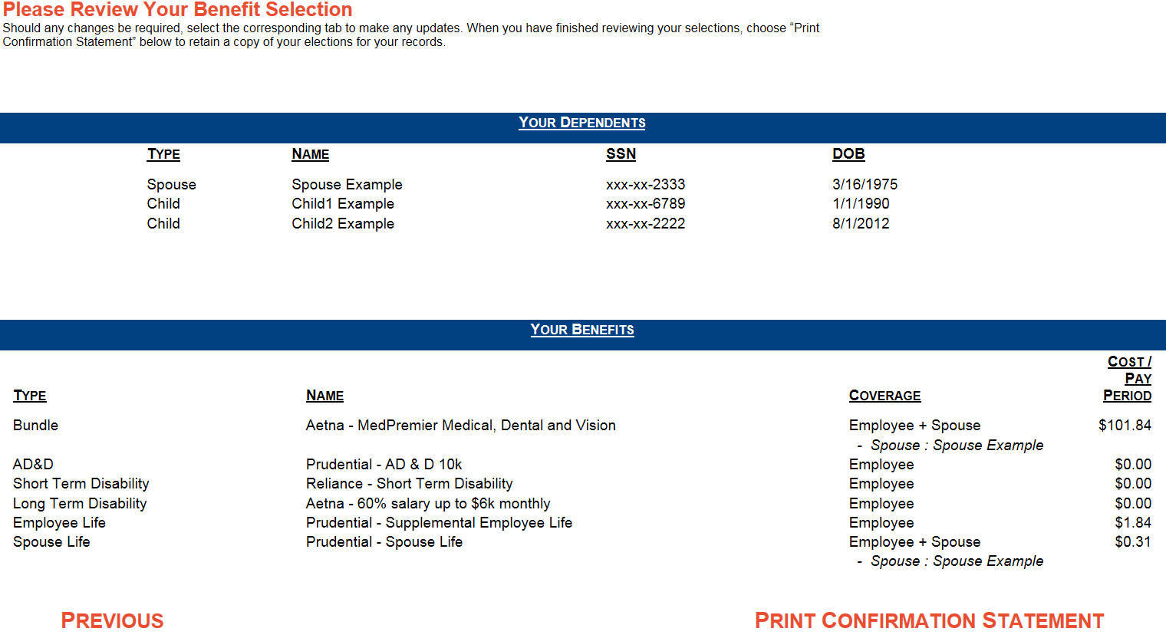
Benefit Summary
Users can review all their plan elections under Benefit Summary.
From here, users may also select Print a Confirmation Statement.

Slide 12
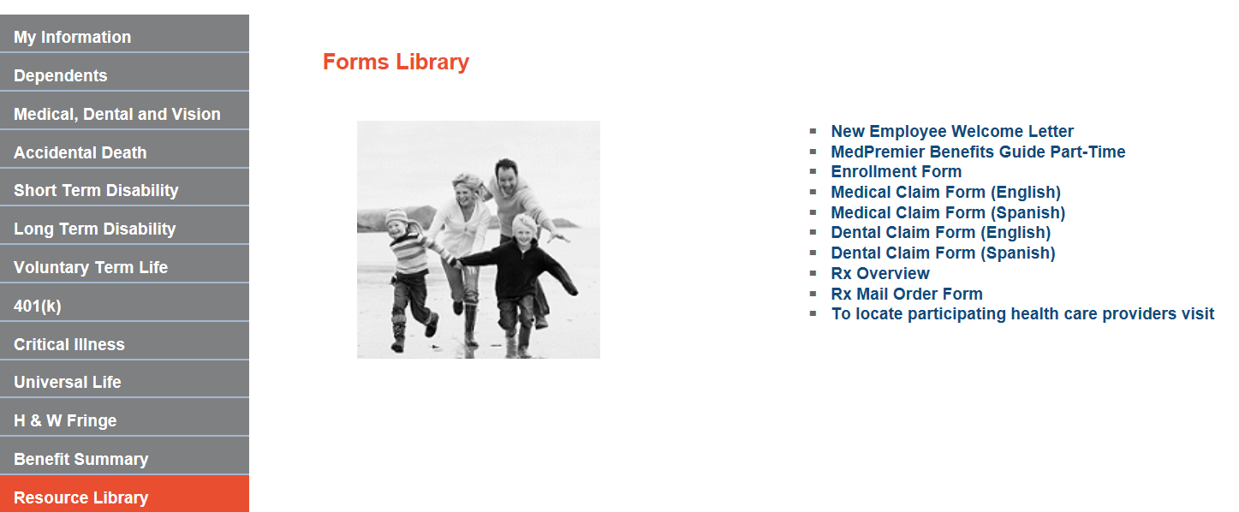
Resource Library
This area is customizable and can include any documents, or links to videos or websites, that the employer would like posted as resources for employees.
Examples: Carrier websites,
Plan Documents, Doctor Finder
and Claims Forms.

